Slide 1
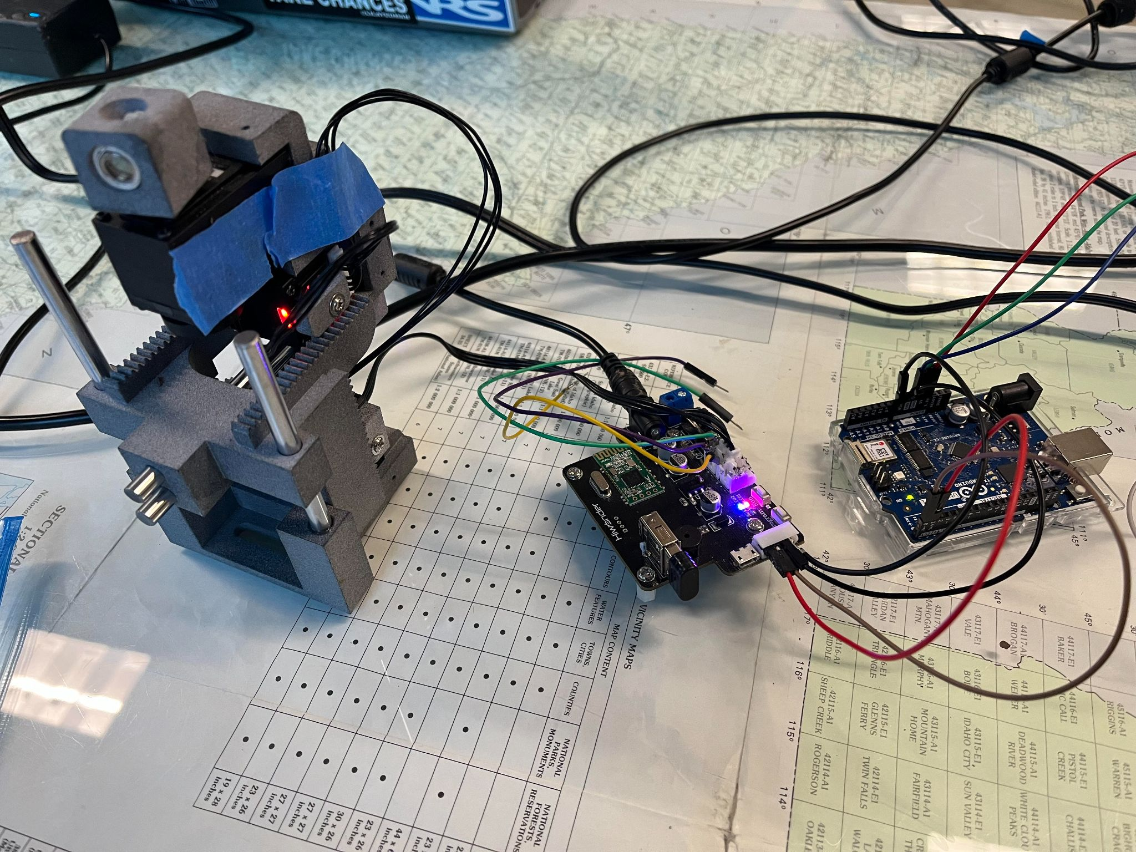
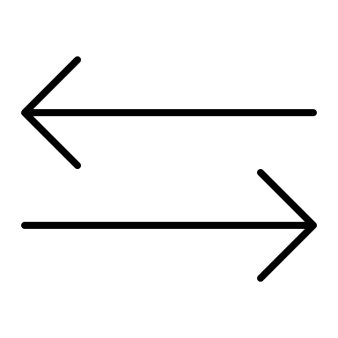
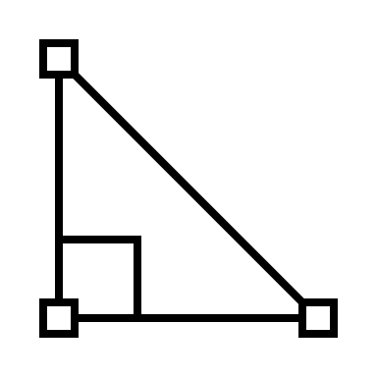

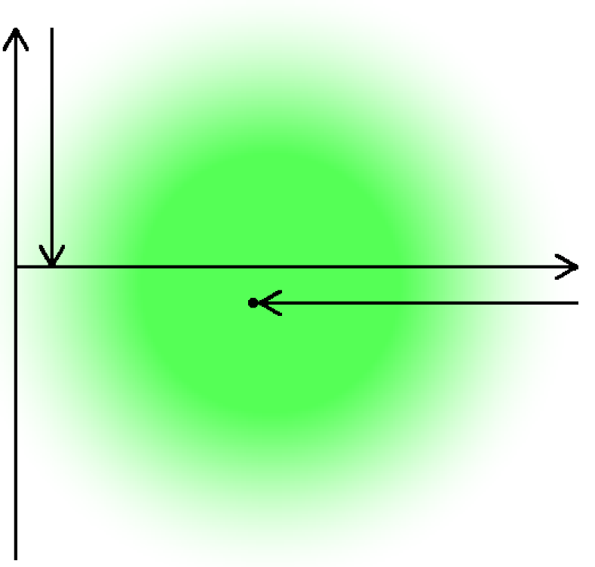

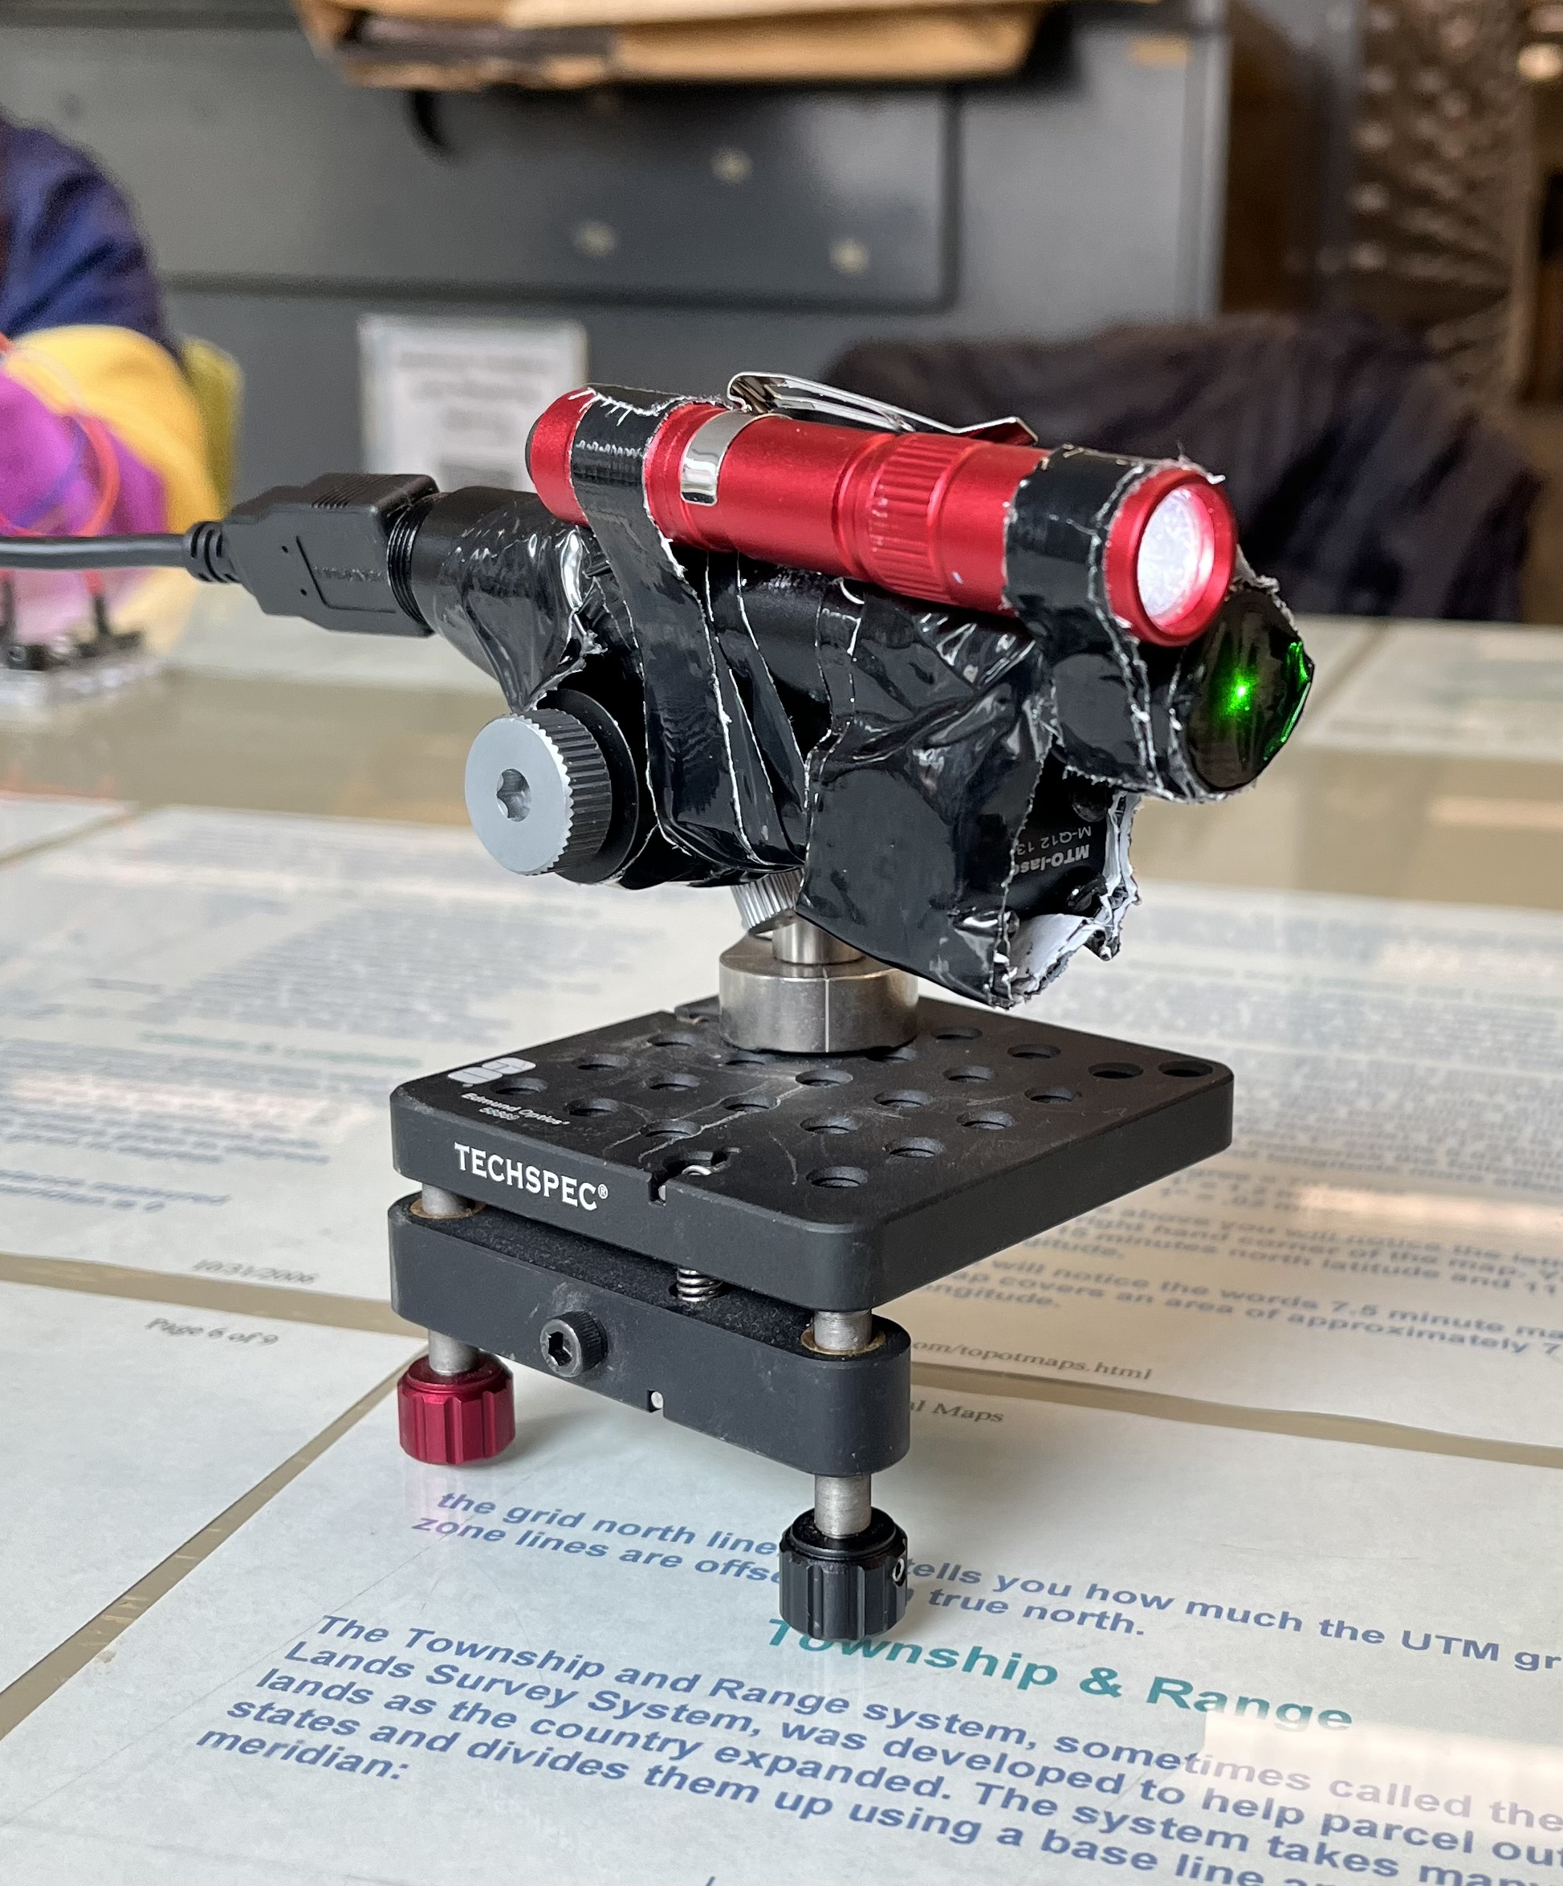
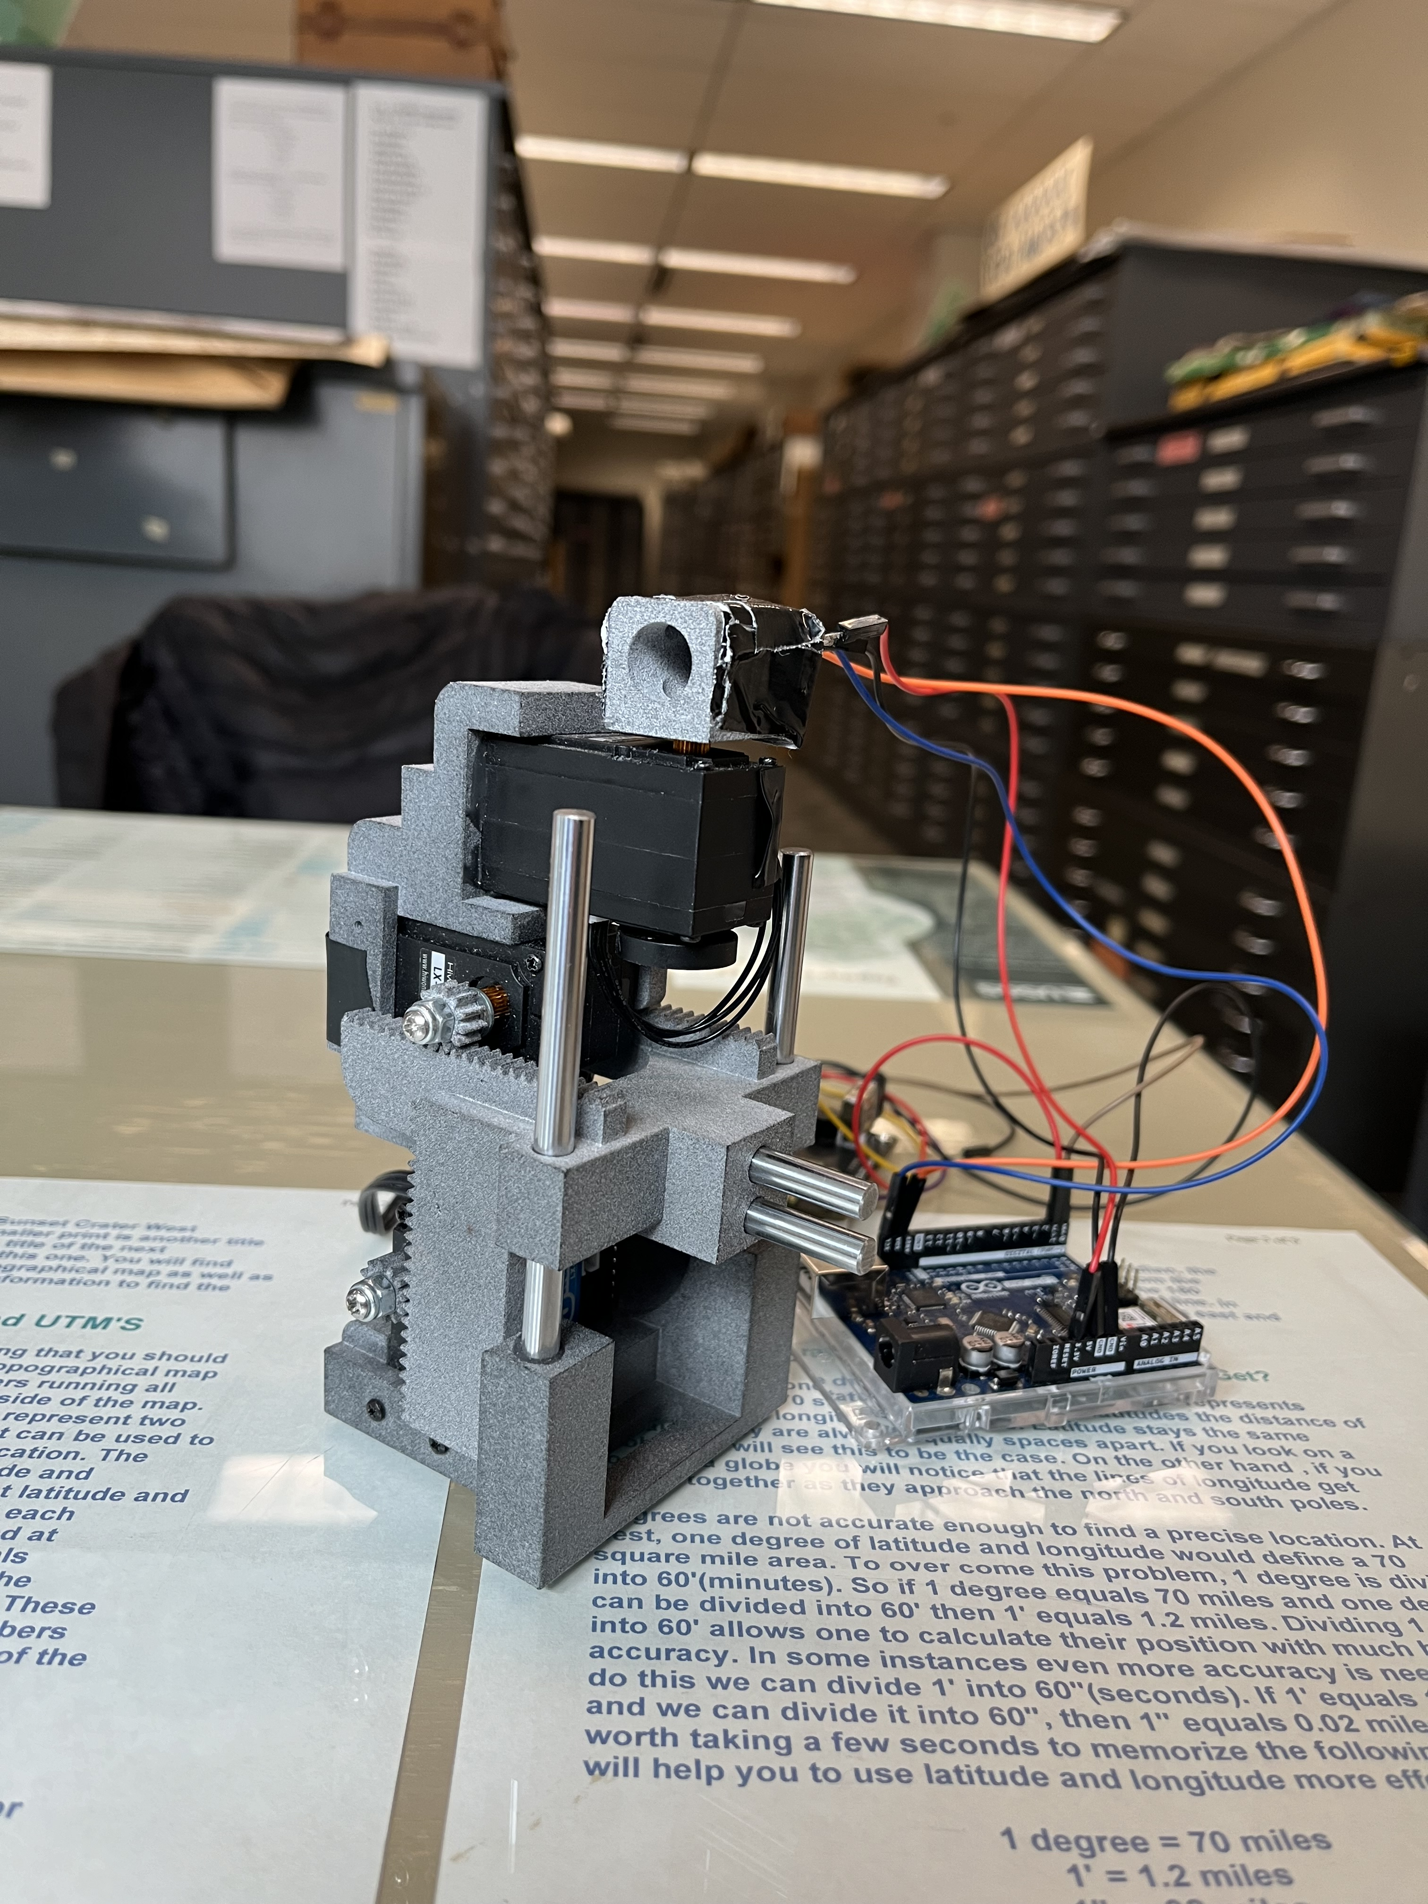




Intensity-based Alignment of Laser Devices
Developed By: Track Tech
Dawson Burgess, Spencer Butler, Marissa Samayoa
Lead Instructor: Bruce Bolden
Client: JP Hansen – Hansen Photonics
Objective
Conceptual development
Validation
Automate alignment of an optical receiver to a laser source, based on the measured light intensity at different positions. Reach optimal alignment by achieving maximum intensity.
Alignment worked at 6 feet.
Alignment worked at minor offset angles, as well as at 45 and 90 degrees.
Transmitter weighs 1.25lbs and receiver weighs 1.06lbs.
Alignment does not require user input after beginning the process.
Design software for alignment of laser devices via optical intensity.
Language: Arduino C++
Environments: VS Code Platform IO
Background
Hansen Photonics Inc. is a small, family company located in Burien, Washington. They contribute to the computer networking industry with patents that cover modular networking hardware devices and systems. HPI works with universities, environmental science centers, and small businesses to help provide new, cutting-edge hardware solutions for everyone.
Final design
Final Process:
Find the brightest position along the R-axis, corresponding to the angle towards the broad light source.
Switch the light sensor to lowest gain, to support measuring the laser, which is very bright.
Alternate between optimizing along the X, Y, and R axes, searching for the brightest point upon each.
Continue until reaching a point where the measured value is sufficiently large.
Value proposition
Optical transfer allows for greater data transfer capacity than electrically. It can be implemented in a cost effective and environmentally friendly way via lasers. This requires very precise alignment between two devices, potentially taking hours of labor to establish a connection. Automating the alignment with software provides significant convenience.
CONCLUSION
The alignment process created meets the desired requirements, aligning the laser to the receiver. However, it may take several minutes, and the receiver may stop when reaching the side of the laser rather than the center. Further development could optimize the speed of the alignment or ensure that the receiver always reaches the exact center of the laser.
Key requirements
This alignment process shall work at a minimum distance of 6 feet.
After program is started, the alignment process is fully automatic.
The finished device weighs less than 10 lbs.
The program is written in a modular, scalable style.
ACKNOWLEDGEMENTS
Dr. Conte de Leon
JP Hansen and Hansen Photonics

